Slide 1

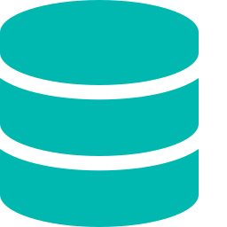



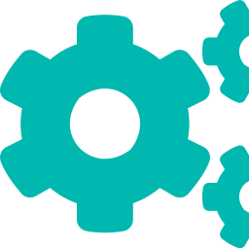

REVIEW 2 · DATABASE INTELLIGENCE INITIATIVE
AUTONOMOUS DATABASE
MONITORING & OPTIMIZATION
PLATFORM
From concept to intelligent system: a self-learning, self-healing platform that observes database health in real time, diagnoses issues autonomously, and takes corrective action before performance ever degrades.
MONITOR
DETECT
OPTIMIZE
HEAL
Major Project Presentation
Autonomous Database Monitoring and Optimization Platform
1

Slide 2




The Problem
Why intelligent, self-managing database infrastructure is now essential
Reactive, Not Proactive
DBA Overload
Costly Downtime
Slow Root-Cause Analysis
Issues surface only after performance has already degraded or users are complaining.
Skilled administrators are stretched thin across growing, distributed database fleets.
Even minutes of degraded performance translate directly into lost revenue and trust.
Diagnosing query bottlenecks and lock contention manually can take hours per incident.
Bottom line: traditional monitoring tools raise alarms after the damage is done — teams are left to react under pressure and tune performance through trial and error.
Autonomous Database Monitoring and Optimization Platform
2

Slide 3





System Architecture
A five-layer pipeline that turns raw telemetry into autonomous action
STAGE 1
STAGE 2
STAGE 3
STAGE 4
STAGE 5
Data Collection
Ingestion & Streaming
Intelligence Layer
Decision & Action
Dashboard & API
Read-only agents & JDBC/ODBC connectors across MySQL, PostgreSQL, MongoDB, Oracle
Time-series store + message queue buffer real-time CPU, I/O, latency & lock telemetry
Anomaly detection & forecasting models score every incoming metric window
Self-tuning engine adjusts indexes, query plans & resource allocation
Unified cross-engine view, alerts, and audit trail for DBA teams
Continuous feedback loop — outcomes retrain the intelligence layer
Deployment: microservice architecture on Docker/Kubernetes, scaling horizontally with the monitored database fleet.
Autonomous Database Monitoring and Optimization Platform
3

Slide 4
Literature Review
Prior work on ML-driven database tuning, query optimization, and self-healing systems
Study | Approach | Key Contribution / Limitation
Van Aken et al., 2017 OtterTune (CMU) | Bayesian Optimization (Gaussian Processes) | Automates DBMS knob tuning from historical workloads — but static, config-only; no real-time anomaly response.
Zhang et al., 2021 CDBTune+ | Deep Reinforcement Learning (DDPG), end-to-end | Tunes cloud DB configs automatically — needs costly repeated workload replay; coarse-grained (read/write only).
Li et al., 2019 QTune | Query-aware Deep RL | Finer-grained, query-level tuning improving on CDBTune — still limited to configuration, not full-stack monitoring.
Marcus et al., 2021 Bao (MIT / Microsoft) | Bandit RL + Tree-CNN (Thompson Sampling) | Learns query-plan hints, adapts to workload/schema drift — scoped only to query optimization, not anomaly detection.
2025 (arXiv) Meta-Learning Self-Healing DB | MAML + GNN + Multi-objective RL | First to combine anomaly detection, failure prediction & recovery — notes no prior work integrates all three end-to-end.
Sources: SIGMOD 2017 (OtterTune), VLDB Journal 2021 (CDBTune+), VLDB 2019 (QTune), SIGMOD 2021 (Bao), arXiv 2507.13757 (2025).
Autonomous Database Monitoring and Optimization Platform
4

Slide 5




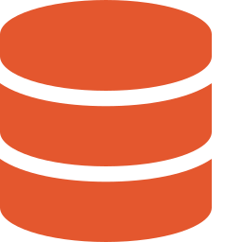
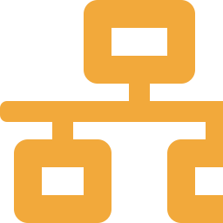


Research Gap
What existing systems still don't solve — and where this project fits
GAPS IN PRIOR WORK
Siloed optimization
HOW THIS PROJECT ADDRESSES IT
Each system tunes one layer only — configs (OtterTune, CDBTune) or query plans (Bao) — never the full monitor-diagnose-act pipeline.
Unified closed loop
One pipeline spans collection through self-healing (Observe→Detect→Diagnose→Decide→Act→Verify), not just tuning.
Offline, not live
Most tuning relies on replaying recorded workloads or benchmarks rather than reacting to continuous production telemetry.
Live, not offline
Decisions are driven by continuous real-time telemetry, not replayed workload traces.
Single-engine scope
OtterTune, CDBTune and QTune target one relational engine (PostgreSQL/MySQL); little cross-engine or NoSQL support.
Cross-engine by design
One intelligence layer reasons across relational and NoSQL systems under a shared model.
No verified autonomy
Guardrailed autonomy
Few frameworks pair autonomous action with closed-loop verification and rollback guardrails for safety.
Every automated action is verified post-execution, with rollback if it doesn't improve the target metric.
Autonomous Database Monitoring and Optimization Platform
5

Slide 6

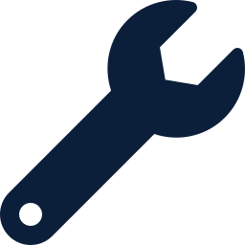

Results & Conclusion
Why the platform is useful — and what makes it different
TARGET OUTCOMES
Faster
CONCLUSION
Anomaly detection — flags deviations within seconds of onset, not after user impact
The platform reimagines database administration — shifting it from reactive firefighting to continuous, intelligent self-management that observes, decides, and acts on its own.
Fewer manual fixes
Routine tuning (indexes, plans, resources) handled without DBA intervention
Closed-loop autonomy
Higher uptime
Detects, decides and remediates in one continuous cycle — not just alerting.
Predictive maintenance schedules corrective action before failure occurs
Cross-engine intelligence
Minutes, not hours
One reasoning layer spans relational and NoSQL systems, not siloed tools.
Root-cause correlation replaces manual log-diving during incidents
Predictive, not reactive
Design targets for the autonomous pipeline now under development — to be validated against live workload benchmarks.
Forecasts capacity and failure risk days ahead of time.
Next: hybrid & multi-cloud, zero-touch database operations.
Autonomous Database Monitoring and Optimization Platform
6

